Slide 1
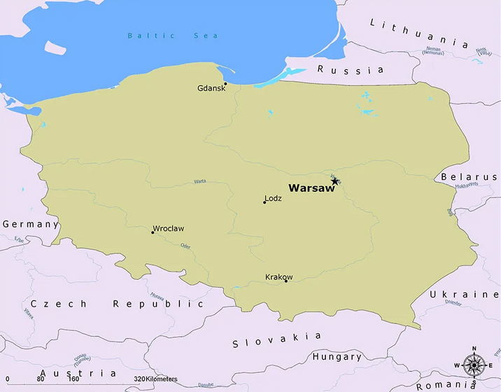
Title: Sabbatical Report
Researcher: Amir R. Askari, PhD
Host Institution: Department of Automation, Biomechanics and Mechatronics, Lodz University of Technology, Lodz, Poland

Slide 2
Travel to Poland
Poland Embassy: Tehran، No. 2 Pirouz St., Africa Expressway (Nelson Mandela Ave.)
Visa types: <90 days: C –Type (Schengen)
>90 days: D –Type (National)
https://secure.e-konsulat.gov.pl/
Air ticket: Imam Khomeini (IKA) – Istanbul (IST) -Warsaw Chopin (WAW)
Imam Khomeini (IKA) – Hamad (DOH) -Warsaw Chopin (WAW)
Shahid Hasheminezhad (MHD) - Hamad (DOH) -Warsaw Chopin (WAW)
Living costs:
Renting a one-bedroom apartment in city center: 2000.00 PLN/month
Other expenses: 1000.00 PLN/month/person
https://www.numbeo.com/cost-of-living/in/Lodz

Slide 3
Living in Poland
Language: Polish
Population: 37.78 million
National currency: Zloty (PLN), each zloty is divided into 100 Groszy
Major cities: Warsaw, Kraków, Łódź, Wrocław, Poznań, Gdańsk
Major bank: PKO
Major mobile operators: T-mobile, Orange, Play, Plus
Online shopping: allegro.pl
Online tickets: koleo.pl

Slide 4
The project in which I was involved:
Title of the project: Modelling and nonlinear dynamics of magneto-electro mechanical systems
Duration of the project: 8 months (Feb. 2021 - Aug. 2021)
Grant OPUS 14 No. 2017/27/B/ST8/01330.

Slide 5
The Grant ULAM:
Stanisław Marcin Ulam (Polish mathematician 1909 -1984)
https://nawa.gov.pl/en/scientists/the-ulam-programme
Aim: Internationalization of Polish institutions of science and higher education
Duration: 6 – 24 months
Amount: 10,000.00+2,000.00+1,000.00(n) PLNs / month
Along with a mobility allowance (12,000.00+5,000 PLNs)
Activities:
Conducting research and/or development work
Completing a Post-doctoral fellowship
Obtaining materials for scientific work or publication
Openings: Mid February – Mid May

Slide 6
The Grant ULAM:
Eligibility conditions: A person is eligible to apply for the grant if he/she
has a PhD degree
employed at a foreign HEI or a foreign scientific/research center (The employment is not required for persons who obtained their doctoral degree within the last nine months)
had not studied or worked in Poland within 3 years before the date of deadline of the call
has minimum 3 achievements (within the last five years) out of the following:
a publication published in English, as the main author
a reviewed research monograph published in English
a publication in English in reviewed materials from an international conference, indexed in the Web of Science Core Collection or Scopus database
has an invitation from the Host institution

Slide 7
The Grant ULAM:
Evaluation:
Preselection based on the Applicant's achievements
Sending to two external reviewers
Final selection

Slide 8
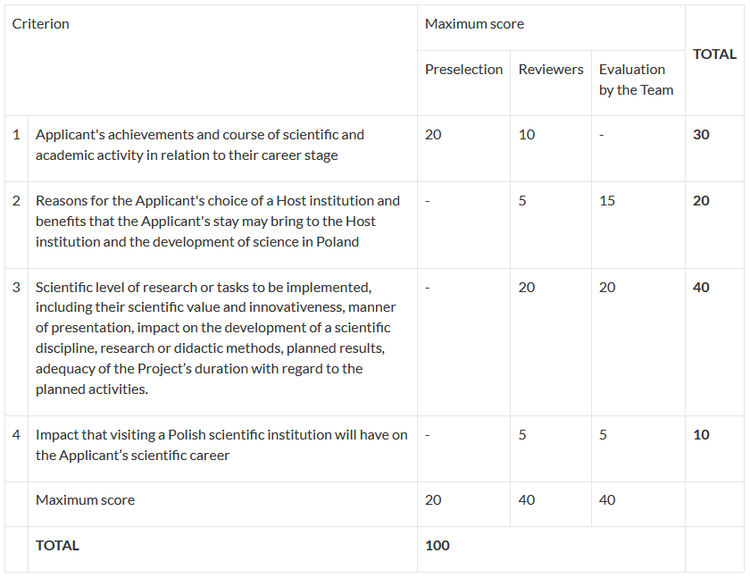
The Grant ULAM:
Evaluation:

Slide 9
Thanks for your patience!

